Slide 1
Hybrid CTC/Attention Architecture for End-to-End Speech Recognition
Jinnan Li
Ttic 31110

Slide 2
content
Introduction and Motivation
Connectionist Temporal Classification
Improving LSTM-CTC based ASR
AttentionMechanism
HYBRID CTC/ATTENTION
Experiements and Results

Slide 3
Introduction and motivation
There are two major types of end- to-end architectures for ASR; attention-based methods use an attention mechanism to perform alignment between acoustic frames and recognized symbols, and connectionist temporal classification (CTC) uses Markov assumptions to efficiently solve sequential problems by dynamic programming.
The basic attention-based mechanism has an advantage that it does not require any conditional independence assumptions. However, it is too flexible in the sense that it allows extremely non-sequential alignments.
The paper proposed a mechanism to take advantage of the constrained CTC alignment in a hybrid CTC/attention-based system.

Slide 4
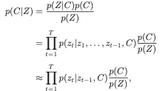



Connectionist Temporal Classification
Follows from Bayes decision theory.
Define an an augmented letter sequence, C’
C′ = {<b>,c1,<b>,c2,<b>,...,cL,<b>}
={c′l ∈U∪{<b>}|l=1,...,2L+1}
and framewise letter sequence with an additional blank symbol,
Z = {zt ∈ U ∪ {< b >}|t = 1, . . . , T }.
We can solve the problem by finding argmax C in C’ of the objective

Slide 5
Improving LSTM-CTC based ASR
Long Short Term Memory (LSTM), and in general, recurrent neural network (RNN) based ASR systems trained with connectionist temporal classification (CTC) when data is abundant.
We want to improve the performance of this mechanism in domains with limited training data.

Slide 6
Improving LSTM-CTC based ASR
Several improving schemes:
Instead of initializing weights and biases to random values in the interval [-0.1,0.1], we initialize the forget gate bias, bf , to a large value, say 1, that will force the gate to be initialized in an open position and allow memory cell gradients in time to flow more readily.
Data Augmentation
Stacking and striding frames
Dropout on feedforward connections

Slide 7
Improving LSTM-CTC based ASR
Librispeech | 1h CER (clean-dev) | 1h valid WER (clean-dev) | 10h valid CER (clean-dev) | 10h valid WER (clean-dev)
Wav2vec+CTC (baseline) | 11.31 | 27.05 | 8.5 | 22.71
Wav2vec+DNN+CTC | 100 | 100 | 83.95 | 100
Wav2vec+LSTM+CTC (random initialization) | 100 | 100 | 99.51 | 100
Wav2vec+LSTM+CTC (b_f=1) | 100 | 100 | 100 | 100
Wav2vec+LSTM+CTC (b_f=1, minimum 6 epochs) | 100 | 100 | 99.72 | 100
Wav2vec+LSTM+CTC (b_f=1, minimum 8 epochs) | 100 | 100 | 100 | 100

Slide 8

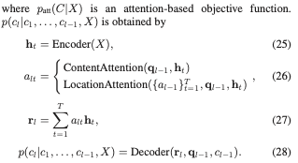
Attention Mechanism
Compared with the CTC approach, the attention-based approach does not make any conditional independence assumptions, and directly estimates the posterior, p(C|X ), on the basis of a probabilistic chain rule, as follows:

Slide 9

HYBRID CTC/ATTENTION
Multiobjective Learning
uses a CTC objective function as an auxiliary task to train the attention model encoder within the multiobjective learning (MOL) framework.
the forward–backward algorithm of CTC can enforce a monotonic alignment between speech and label sequences during training.
Speed up the alighment process

Slide 10
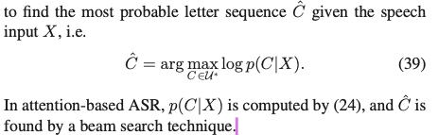
HYBRID CTC/ATTENTION
Joint decoding

Slide 11


HYBRID CTC/ATTENTION
Let Ω_l be a set of partial hypotheses of the length l.
For each step, we expand each partial hypothese in Ω_l-1 by adding one more letter and adding into Ω_l. Find each hypothese h in Ω_l, we compute the score
h = g + c
If c is a special symbol that represents the end of a sequence, <eos>, h is added to Ωˆ but not Ω_l , where Ωˆ denotes a set of complete hypotheses. Finally, Cˆ is obtained by

Slide 12
HYBRID CTC/ATTENTION
Attention-based ASR may be prone to include deletion and insertion errors because of its flexible alignment property;
it may prematurely predict the end-of-sequence label, even when it has not attended to all of the encoder frames, making the hypothesis too short
it may predict the next label with a high probability by attending to the same portions as those attended to before. This case the hypothesis becomes very long and includes repetitions of the same label sequence.

Slide 13

HYBRID CTC/ATTENTION
A conventional way to solve those problems is to add a length penalty.
In our case, we will add the attention objective as a penalty.
The CTC probability enforces a monotonic alignment that does not allow large jumps or looping of the same. Furthermore, it can avoid premature prediction of the end-of-sequence label, which is not handled by the coverage term..

Slide 14
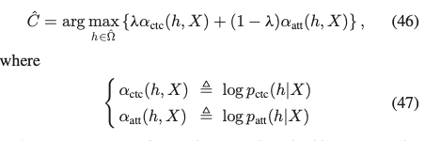
HYBRID CTC/ATTENTION
it is nontrivial to combine the CTC and attention-based scores in the beam search, because the attention decoder performs it output-label-synchronously while CTC perfomrs it frame- synchronously.
The first method is a two-pass approach, in which the first pass obtains a set of complete hypotheses using the beam search, where only the attention-based sequence probabilities are considered. The second pass rescores the complete hypotheses using the CTC and attention probabilities.

Slide 15
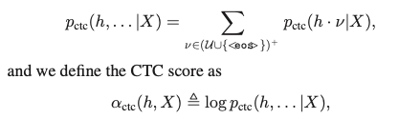
HYBRID CTC/ATTENTION
The second method is one-pass de- coding, in which we compute the probability of each partial hypothesis using CTC and an attention model.
Here, we uti- lize the CTC prefix probability defined as the cumulative probability of all label sequences that have h as their prefix:
where ν represents all possible label sequences except the empty string.

Slide 16
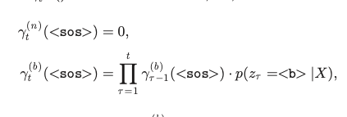
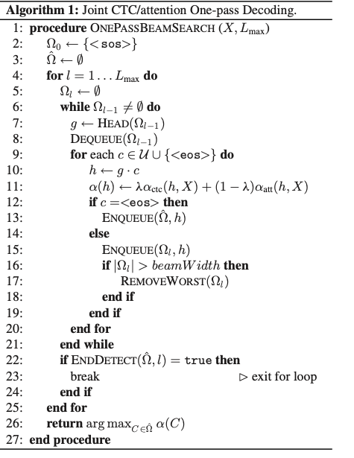
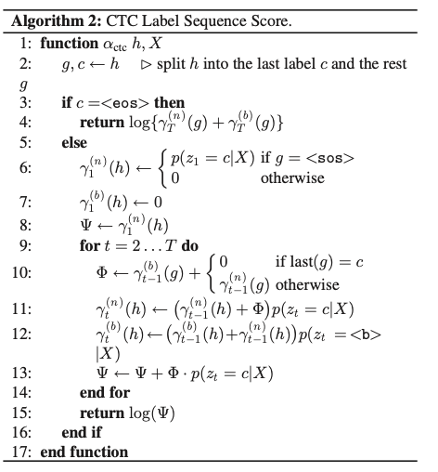
HYBRID CTC/ATTENTION

Slide 17
RESULT
Librispeech | 10hr CER (dev-clean) | 10hr WER (dev-clean)
Wav2vec+cnn+seq2seq | 117.3 | 162.4
MOL (lambda=0.2) | 96.07 | 100
MOL (lambda=0.5) | 84.26 | 100
MOL (lambda=0.9) | 96.31 | 100

Slide 18
citation
1. A pytorch speech toolkit. SpeechBrain. (n.d.). Retrieved June 2, 2022, from https://speechbrain.github.io/
2. Miao, H., Cheng, G., Zhang, P., Li, T., & Yan, Y. (2019). Online hybrid CTC/attention architecture for end-to-end speech recognition. Interspeech 2019. https://doi.org/10.21437/interspeech.2019-2018
3. Moriya, T., Ochiai, T., Karita, S., Sato, H., Tanaka, T., Ashihara, T., Masumura, R., Shinohara, Y., & Delcroix, M. (2020). Self-distillation for improving CTC-transformer-based ASR Systems. Interspeech 2020. https://doi.org/10.21437/interspeech.2020-1223

